Slide 1

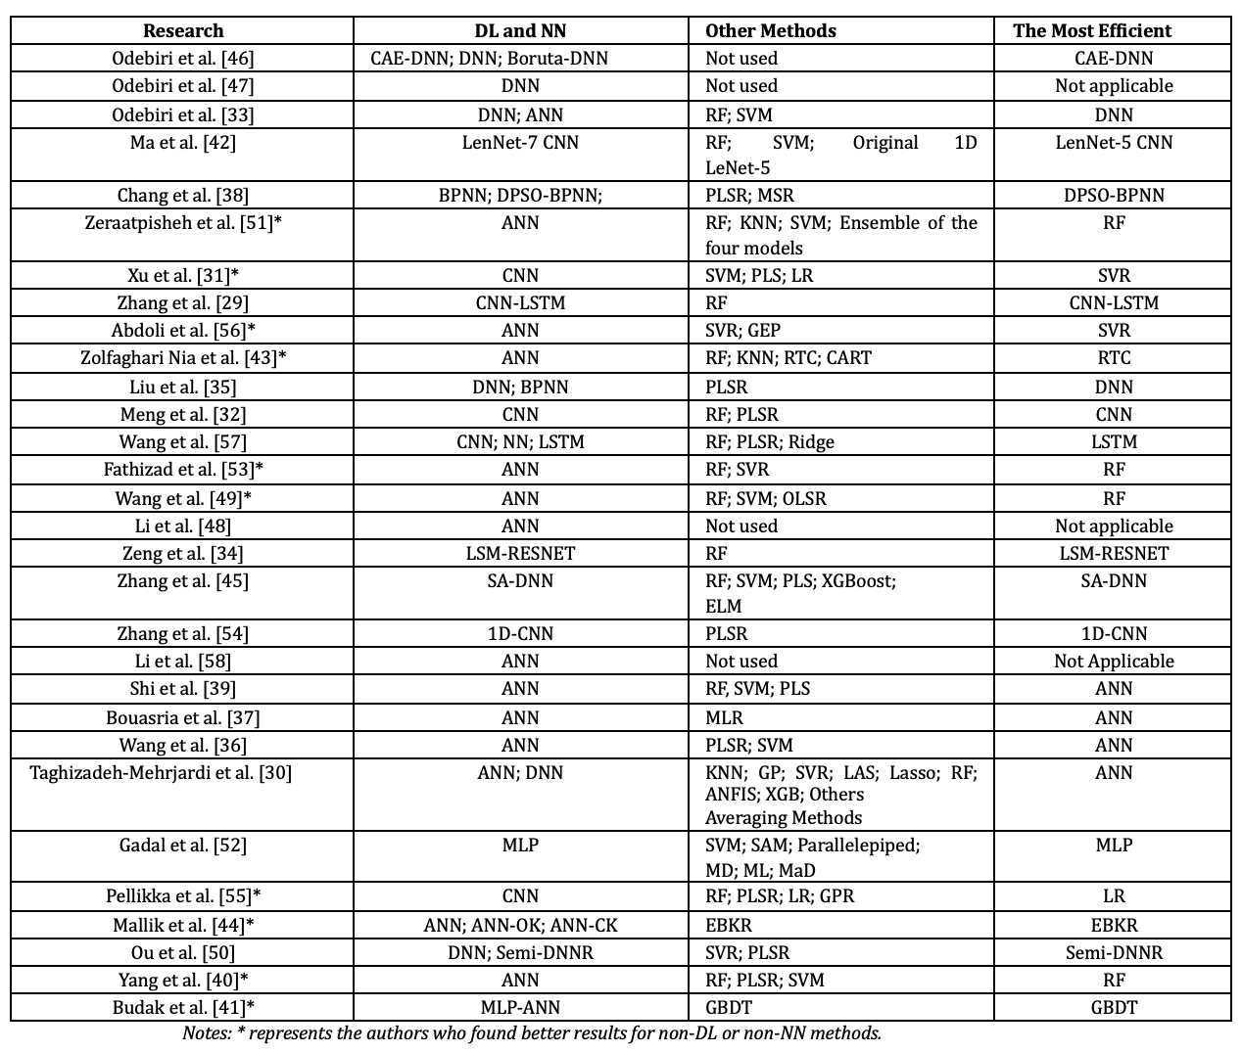
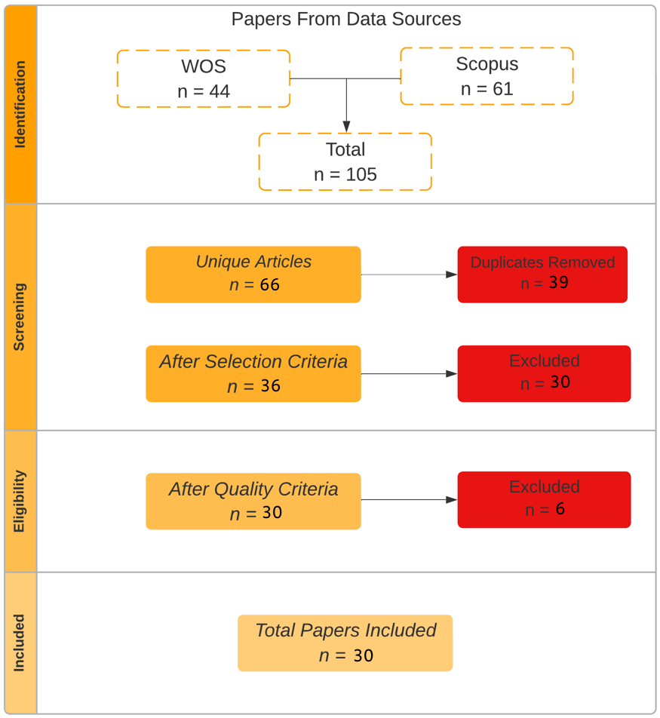
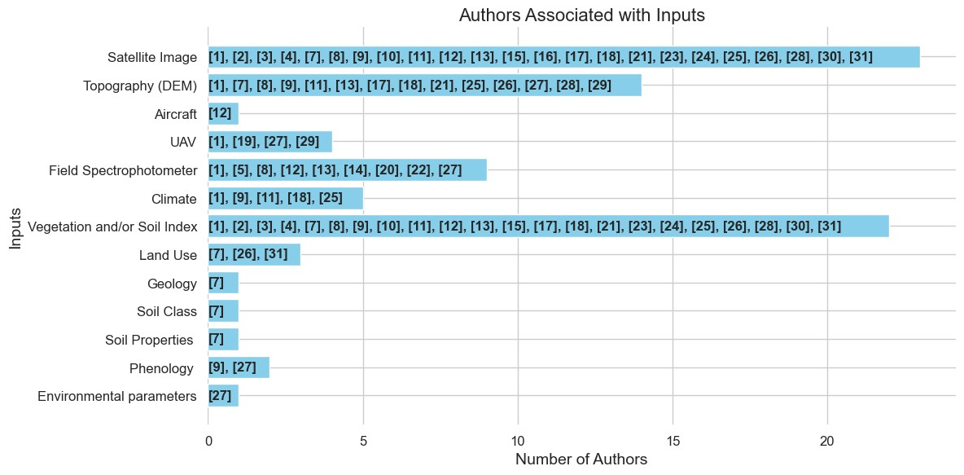
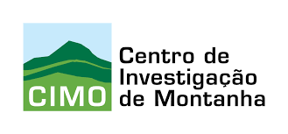





A Literature Review on the Use of ESA Satellite Data for Soil Organic Carbon Estimation Models with Artificial Intelligence Tools
Arthur A. J. Lima^{1,2,3,4}, Zulimar Hernández², Júlio Lopes^{2,4}, Antonio González¹, Rui Pedro Lopes^{2,4} and Tomás de Figueiredo^{2,3}
¹ Universidade da Coruña, Grupo de Investigación Xestión Sostible dos Recursos Hídricos e do Chan (AQUATERRA), 15071 A Coruña, España
² Laboratório Associado para a Sustentabilidade e Tecnologia em Regiões de Montanha (SusTEC), Instituto Politécnico de Bragança, Campus de Santa Apolónia, 5300-253 Bragança, Portugal
³ Centro de Investigação de Montanha (CIMO), Instituto Politécnico de Bragança, Campus de Santa Apolónia, 5300-253 Bragança, Portugal
⁴ Research Centre in Digitalization and IntelligentRobotics (CeDRI), Polytechnic Institute of Bragança, Bragança, Portugal
(E-mail: arthur.lima@ipb.pt, zulimar@ipb.pt, juliolopes@ipb.pt, antonio.paz.gonzales@udc.es, rlopes@ipb.pt and tomasfig@ipb.pt)
Introduction
Artificial intelligence models
Preliminary results underscore how promising Deep Learning (DL) models are in estimating SOC through the use of RS data. Among the studies analyzed, that used both ML and DL techniques, only 10 achieved better results with non-DL methods (Table 1). The possibility is considered that, in studies with an insufficient quantity of SOC samples obtained in the field, the DL methods were not fully leveraged, as methods based on these technologies require a considerable volume of data to achieve good results. This scenario further highlights how promising DL structures are in estimating SOC using RS data.
Agricultural soils play a crucial role in food security and climate change, as the process of accumulation and stabilization of soil organic carbon simultaneously improves the physicochemical properties, such as water retention, aggregate stability, or plant nutrition. For these reasons, knowing the amount of Soil Organic Carbon (SOC) is important to manage climate alarm [1], but the sampling and subsequent laboratory analyses that are traditionally used for this purpose are expensive and time-consuming, which leads to explore alternative non-degrading and environmentally friendly methods. Remote Sensing (RS) arises in this sense, seeking to reduce time consumption and cost [2, 3]. However, the amount of data needed for this type of evaluation requires advanced computer methods for the elaboration of SOC predict models [4]. A Literature Review (LR) was conducted with the aim of finding tools, advances, and gaps in the literature.
Satellite data
Data from the Sentinel satellites were the most used in this literature review. Of the 30 works selected, 23 used satellite data, and the most used by the authors were those from the sentinel collection, totaling 15 works, that is, 65%. The other 7 studies used data from field spectrophotometer or drone/aircraft.
Table 1. Methods used to estimate SOC and the most efficient of them
Methodology
Using the PRISMA method [5], 30 articles that used RS and Artificial Intelligence (AI) to estimate SOC were selected to LR (Fig. 1).
The keywords and synonyms chosen for this research were: “Deep learning” and “Neural network”; “Remote sensing”; “Soil organic carbon” and “Organic matter”. The period covered by this work is from 2021 to August 2023.
Notes: * represents the authors who found better results for non-DL or non-NN methods.
Conclusions
Results
Fig. 1. Conducting stage results of the LR
The inputs most used by the authors were those most correlated with SOC, namely Vegetation and soil indices, some satellite bands and data derived from DEM;
DL models are more robust than non-DL models and can converge better when working with complex RS data, however, a dataset with a large amount of data is required, especially SOC samples;
Data from Sentinel satellites collection were the most used by researchers.
Input data
Vegetation and soil indices (NDVI, SAVI, RVI, EVI and SRCI), specific bands from different satellites (red, red edge, green, SWIR and NIR bands) and Digital Terrain Elevation Models (DEM) using Transportation Radar Topography Mission (SRTM) were the input data of the most commonly used (Fig. 2).
References
[1] N. Agjee, O. Mutanga, and R. Ismail, “Remote sensing bio-control damage on aquatic invasive alien plant species,” South African Journal of Geomatics, vol. 4, no. 4, pp. 464–485, 2015.
[2] M. Mngadi, J. Odindi, K. Peerbhay, and O. Mutanga, “Examining the effectiveness of sentinel-1 and 2 imagery for commercial forest species mapping,” Geocarto International, vol. 36, no. 1, pp. 1–12, 2021.
[3] S. Khanal, J. Fulton, A. Klopfenstein, N. Douridas, and S. Shearer, “Integration of high resolution remotely sensed data and machine learning techniques for spatial prediction of soil properties and corn yield,” Computers and electronics in agriculture, vol. 153, pp. 213–225, 2018.
[4] O. Odebiri, O. Mutanga, J. Odindi, R. Naicker, C. Masemola, and M. Sibanda, “Deep learning approaches in remote sensing of soil organic carbon: A review of utility, challenges, and prospects,” Environmental monitoring and assessment, vol. 193, pp. 1–18, 2021.
[5] J. Cruz-Benito, “Systematic literature review & mapping,” 2016.
(Notes: DEM: Digital elevation mode; Aircraft: Manned Aerial Vehicle; UAV: Unmanned Aerial Vehicle.)
Fig. 2. Inputs used in the researches
Agradecimentos:
Os autores agradecem à Fundação para a Ciência e a Tecnologia (FCT, Portugal) e aos fundos nacionais FCT/MCTES (PIDDAC) pelo apoio financeiro ao CIMO (UIDB/00690/2020 e UIDP/00690/2020), CeDRI (UIDB/05757/2020 e UIDP/05757/2020) e SusTEC (LA/P/0007/2020). E, também, ao financiamento nacional pela FCT, Fundação para a Ciência e a Tecnologia, no âmbito da bolsa de doutoramento 2022.14010.BD de Arthur Aparecido Janoni Lima.

